Slide 1
APPLICATION BASED QUESTION
CSA5117 – CRYPTOGRAPHY AND NETWORK SECURITY
NAME : SARU HASINI.S
REG NO : 192521418

Slide 2
1. Event Communication Security (Caesar Cipher)
Given:
Original Message: MEET AT NOON
Shift = 4 (forward)
Encryption
Plain | M | E | E | T | A | T | N | O | O | N
Cipher | Q | I | I | X | E | X | R | S | S | R
Encrypted Message
QIIX EX RSSR
Decryption
The receiver shifts every letter 4 positions backward.
Example:
Q → M
I → E
X → T
Recovered message: MEET AT NOON

Slide 3
Intercepted Suspicious Message (Caesar Cipher)
Ciphertext
GSRH RH Z HVXIVG
This is encrypted using the Atbash Cipher, where:
A ↔ Z
B ↔ Y
C ↔ X
D ↔ W
Cipher | G | S | R | H
Plain | T | H | I | S
RH → IS
Z → A
HVXIVG → SECRET
Original Message
THIS IS A SECRET
Justification
Atbash substitutes every letter with its opposite alphabet letter.
Repeating patterns remain visible.
Word lengths match:
GSRH → THIS
RH → IS
Z → A
HVXIVG → SECRET

Slide 4
3. Secure Messaging System (Vigenère Cipher)
Plaintext
HELLO
Keyword
KEY
Repeat keyword:
Plaintext | H | E | L | L | O
Key | K | E | Y | K | E
Alphabet values Letter | Value
H | 7
E | 4
L | 11
L | 11
O | 14

Slide 5
Key Values Letter | Value
K | 10
E | 4
Y | 24
K | 10
E | 4
Encryption Plain | Value | Key | Calculation | Cipher
H | 7 | K(10) | 7+10=17 | R
E | 4 | E(4) | 4+4=8 | I
L | 11 | Y(24) | 35 mod 26=9 | J
L | 11 | K(10) | 21 | V
O | 14 | E(4) | 18 | S

Slide 6
4. Suspicious Digital Asset Investigation (Steganography)
How investigators can detect hidden data
Statistical Analysis
Analyze image pixels.
Detect unusual changes in Least Significant Bits (LSB).
Compare pixel distribution with normal images.
Steganalysis Tools
Use forensic software like:
StegExpose
StegSecret
OpenStego Analyzer
zsteg (PNG)
These tools identify hidden messages or suspicious modifications.
Two techniques to improve security of hidden communication
1. Encrypt the secret message before embedding
Even if extracted, the message remains unreadable without the encryption key.
2. Use adaptive/random embedding
Embed data only in selected image regions using a secret key instead of sequential pixels.
This makes detection much harder.

Slide 7
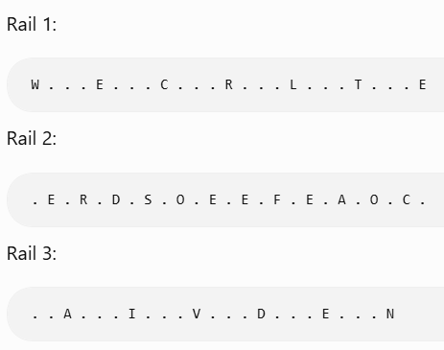
5. Legacy Encryption in Corporate Communication (Rail Fence Cipher)
Ciphertext
WECRLTEERDSOEEFEAOCAIVDEN
This is a 3-Rail Fence Cipher.
a) Original Message
Arrange letters into three rails.
b) Why is this method vulnerable?
It uses only letter rearrangement, not substitution.
No encryption key is required.
Patterns remain unchanged.
Frequency analysis is still possible.
Modern computers can brute-force the small number of rail combinations quickly.

Slide 8
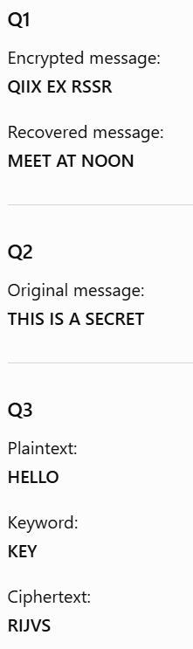
c) Practical enhancement
Replace the Rail Fence Cipher with a modern encryption algorithm such as:
AES (Advanced Encryption Standard)
Advantages:
Strong key-based encryption.
Resistant to brute-force attacks.
Widely used in secure communication.
Provides much stronger confidentiality than transposition alone.

Slide 9
